Slide 1
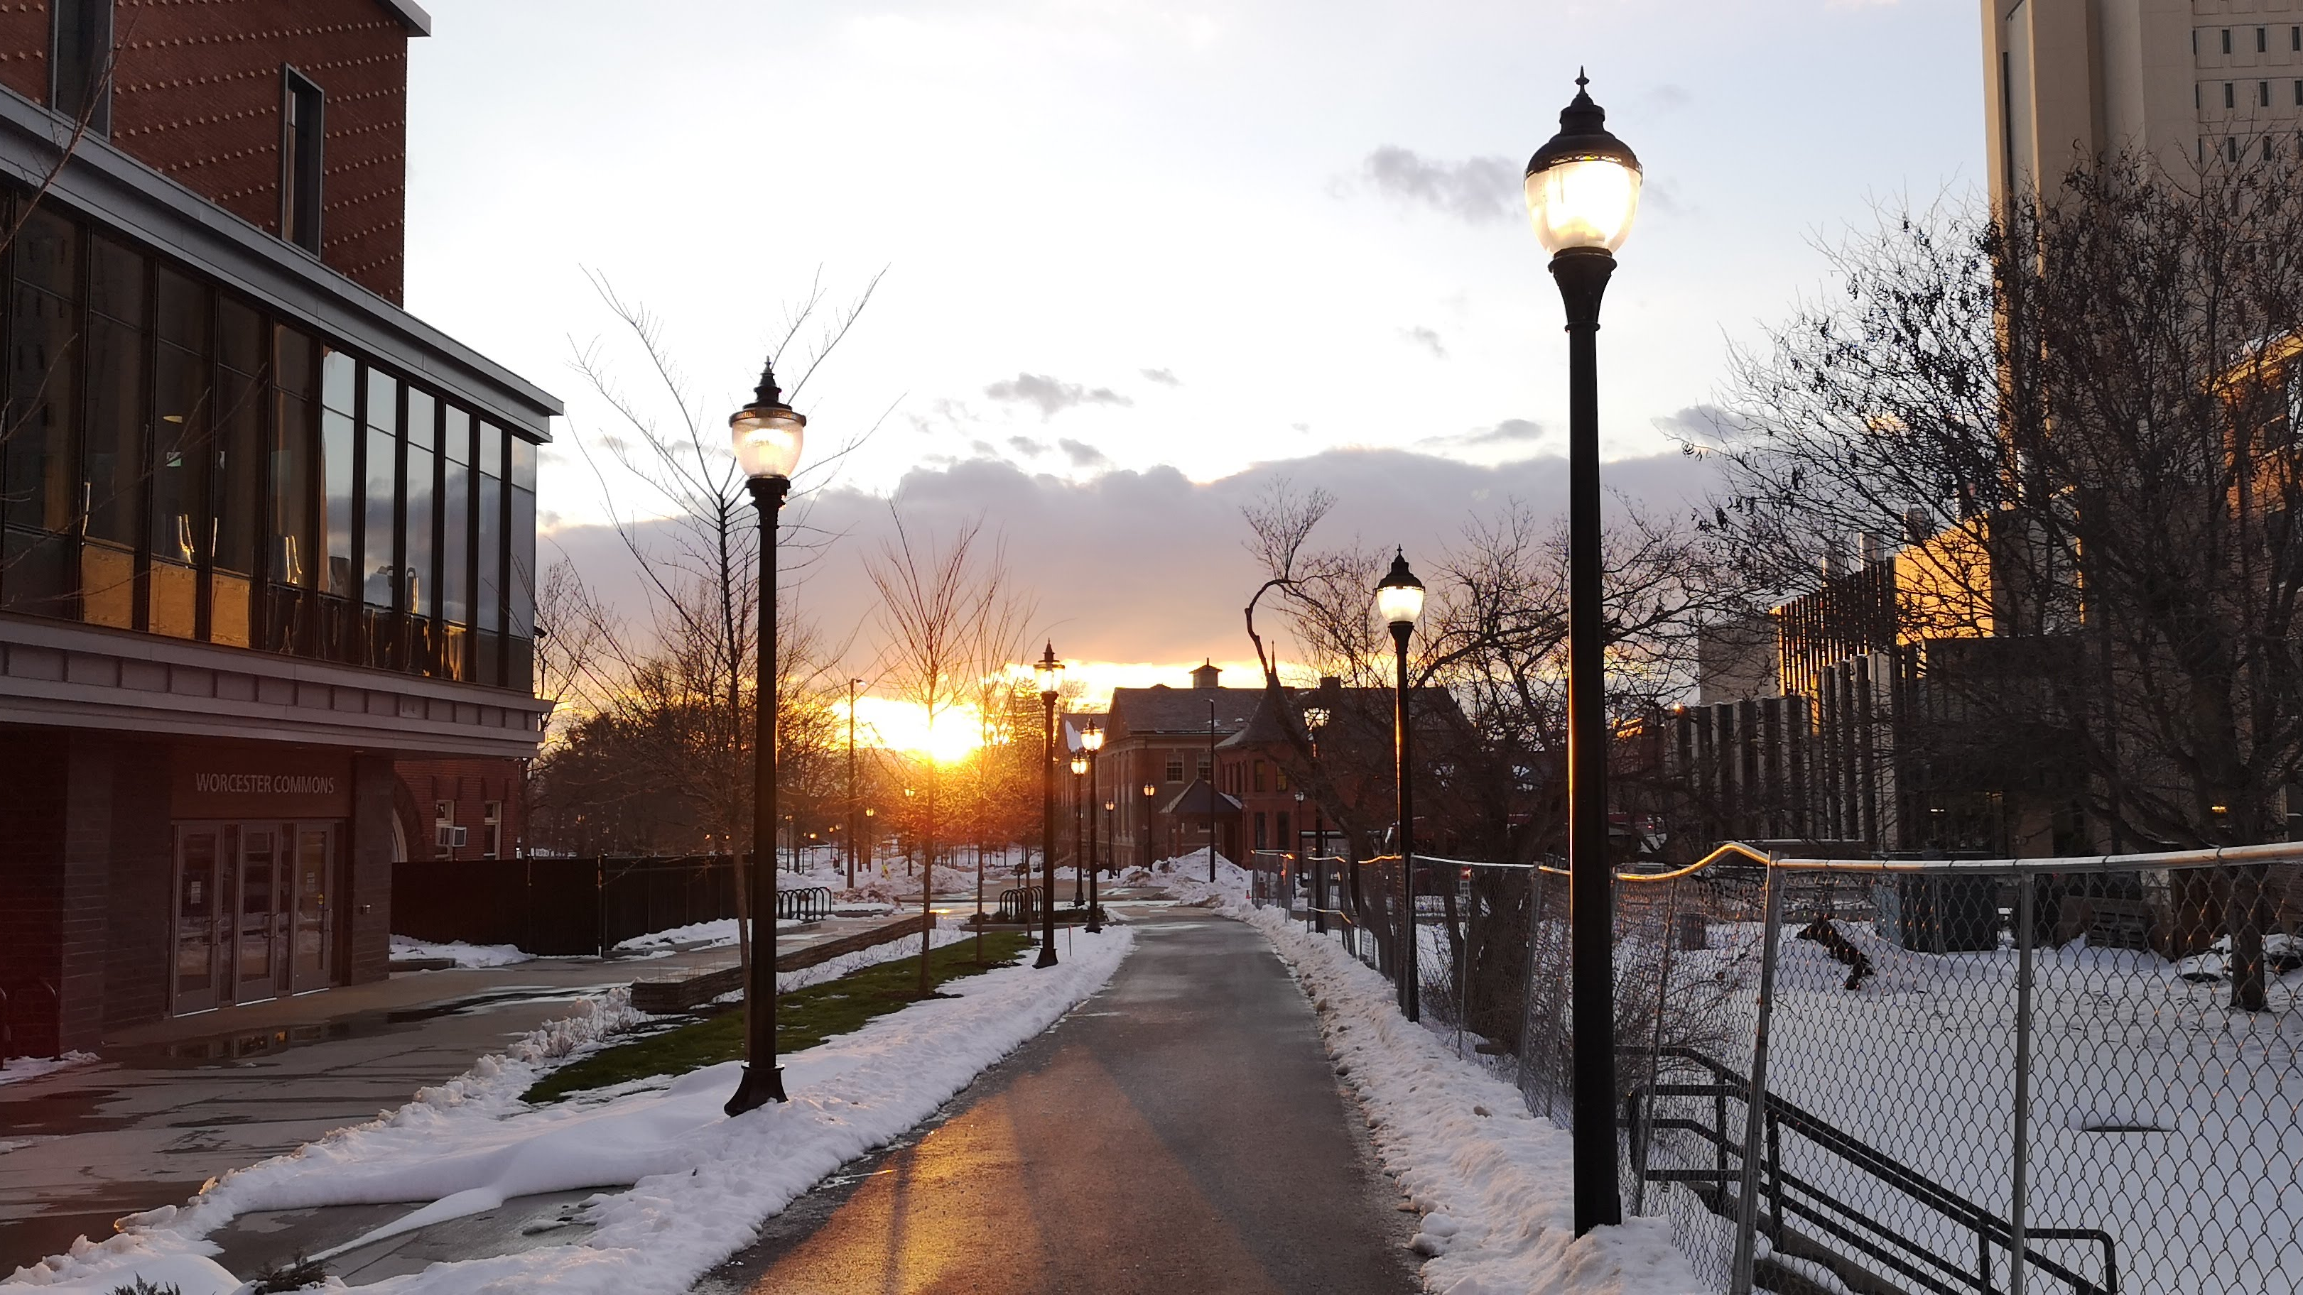
Astronomy 100/1 Lab 2
COVID REMINDERS: Your face mask must cover your mouth AND nose.
If you are feeling at all ill, email your instructor, and don’t come to lab unless you have gotten a negative test.
Spring 2022
Yvonne Ban
UMass Amherst
Amherst, Massachusetts
22 Dec 2020

Slide 2
Important Policies
Please log in to Moodle and carefully review then respond to the Photo Policy Acknowledgement. You won’t be able to get credit for other activities until you do so!
At the end of each lab you will have access to an end-of-lab quiz that is only valid for that lab. You must open it before leaving lab. If for any reason you can’t complete it, you will need to tell your lab instructor before you leave. If you have to leave early, tell us at the beginning of class.
Today’s and future labs will require you to upload pictures that you take, which can be done later.

Slide 3
Part 1: Angular sizes
We will use a uniform grid to get a sense of how to consistently compare the angular sizes we see.
Stand with your eye/camera located 12 ft from the screen.
Look at the floor plan to determine where you should stand.
Sketch some things as they appear on the grid.
Be consistent! E.g. if you are using 4 fingers at arm’s length, always hold them out at full arm’s length.
Keep the worksheet to reference later about angular sizes.

Slide 4
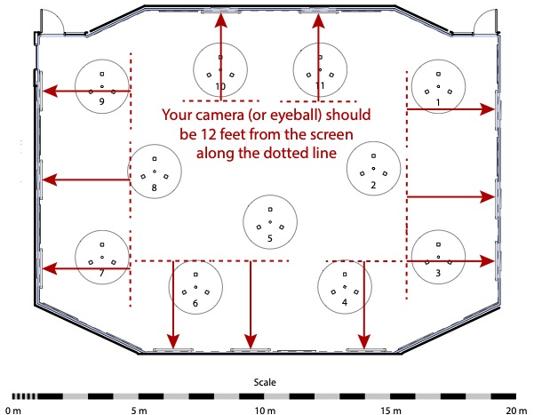

Slide 5
SPECIAL NOTES FOR AT-HOME DIY USE – 1
Find the biggest screen you can and expand these slides as large as you can.
On the following slide, use a ruler to measure the height of the grid (12.5 boxes). Write this down.
Multiply the height you found by 4.6 (so if the height of the grid was 10 inches, then your result would be 46 inches)
Hold your camera (or eye) at that distance from the screen. Zoom in all the way. Complete the activities.

Slide 6
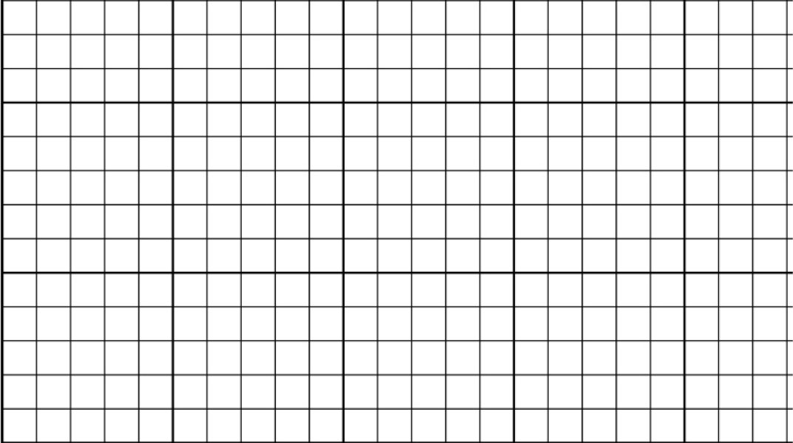
ZOOM IN
BACK UP
1x1

Slide 7
Part 2: Camera Angular Field of View
Let’s do this with your camera to calibrate it.
Hold your camera at the same position as before, i.e. 12 ft from the screen.
Zoom in as far as you can on your camera.
Take a photo of the grid. Use the photo to determine the field of view of your camera.
Answer the questions on your worksheet.

Slide 8
Part 2: Simulating the Sky
Look at the Stellarium view projected on the screens. It simulates a real-life view of the night sky at the same scale as the grid.
Use similar things to those in Part 1 (fingers, coin, etc.) to estimate angular sizes and answer the questions on your worksheet.
Remember to be consistent! Hold your arm out at full length!
Take a photo of the projected Moon like you did for the grid:
Fully zoomed in
Held at 12 ft from screen
Answer the questions on your worksheet.
DIY: Maintain the same screen size and distance from the screen as you used with the grid.

Slide 9
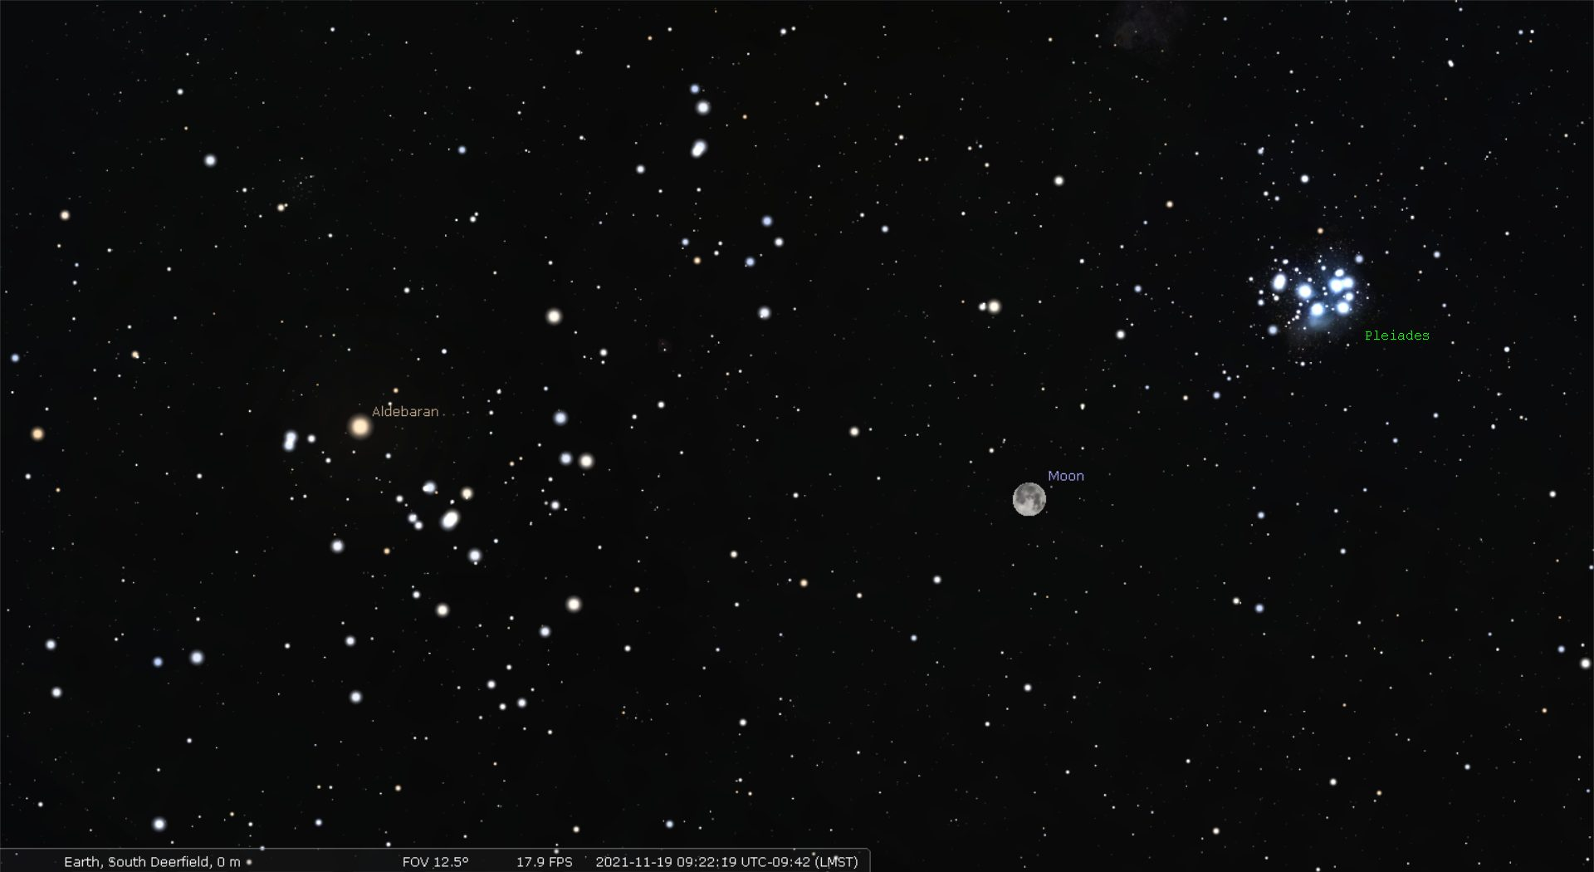

Slide 10
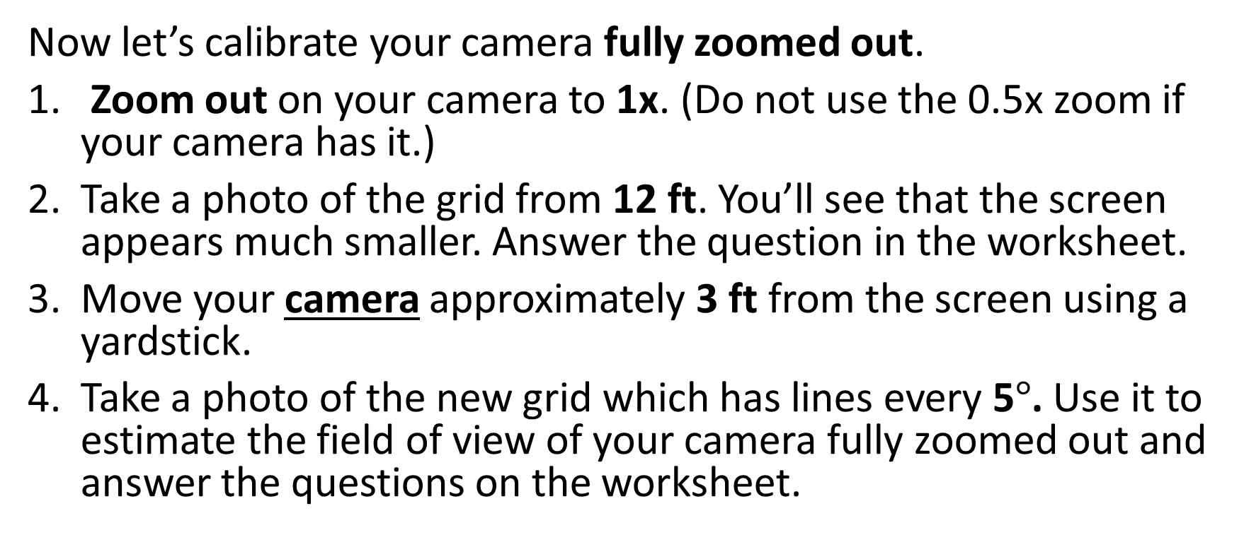
Part 3: Viewing the sky
Now let’s calibrate your camera fully zoomed out.
Zoom out on your camera to 1x. (Do not use the 0.5x zoom if your camera has it.)
Take a photo of the grid from 12 ft. You’ll see that the screen appears much smaller. Answer the question in the worksheet.
Move your camera approximately 3 ft from the screen using a yardstick.
Take a photo of the new grid which has lines every 5$°$. Use it to estimate the field of view of your camera fully zoomed out and answer the questions on the worksheet.

Slide 11
SPECIAL NOTES FOR AT-HOME DIY USE – 2
Make sure you’ve completed the previous parts.
Take the distance you found earlier (for the zoomed-in picture) and divide by 4.
If your result before was 46 inches from the screen, you would now get 46/4 = 11.5 inches
Hold your camera at this new distance from the screen. Zoom out to 1x (no less!). Complete the activities.

Slide 12

ZOOM OUT
STEP UP
5x5

Slide 13
Part 3: Simulating a wide-field view of the sky
Look at the Stellarium view projected on the screens. It simulates a real-life view shortly before sunset.
With your camera 3 ft from the screen, take a photo of the screen.
Answer the questions in the worksheet and write them down for the quiz.
NOTE: You will need to upload your calibration pictures on Moodle by the end of the week.
If you switch to a new camera or change your settings, there will be opportunities to re-calibrate your camera with the grids in future labs.
DIY: Maintain the same screen size and distance from the screen as you used with the second grid.

Slide 14
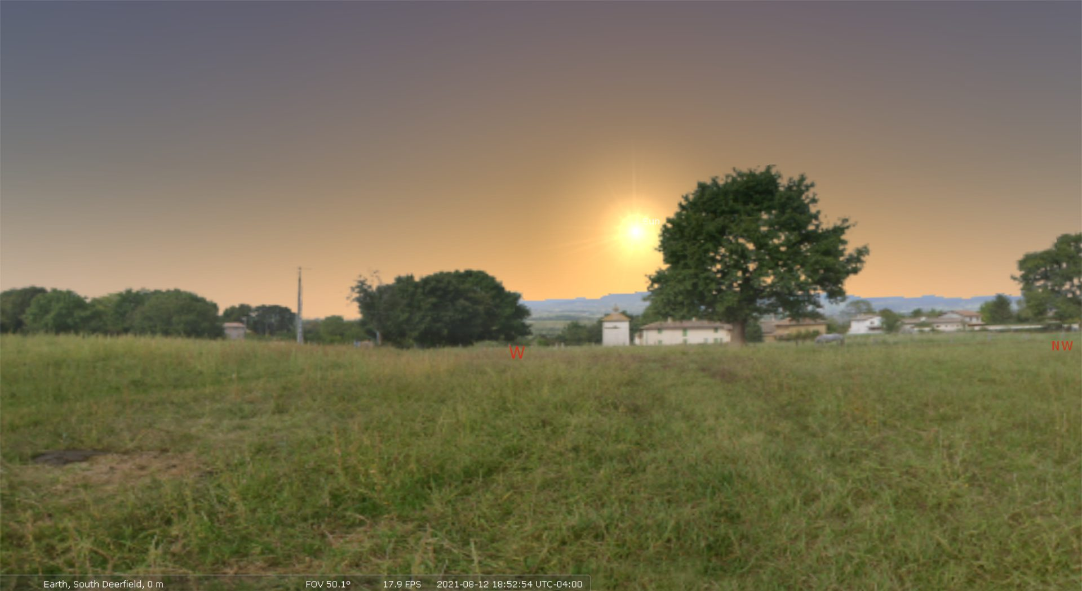

Slide 15
Project: Admiring the Sunset for Credit
You can do either the sunset OR sunrise, as long as you are consistent for all pictures.
Pick a spot that:
You can get to again regularly later in the semester
Has a clear view of the horizon
The sunset(/sunrise) will shift along the horizon over time, so keep that in mind. In the spring, the sunset with shift north, which is to the right, and vice versa for the sunrise.
Has features on the horizon that allow you to pinpoint how the sunset moves over time
An ocean view isn’t useful unless there are fixed features you can use, like islands.
You will precisely document so others can replicate your pictures.

Slide 16
Project: Admiring the Sunset for Credit
Take a picture:
With your camera zoomed out to zoom factor 1
Within about 5 degrees of the horizon
In which the Sun’s azimuth can be clearly discerned
Don’t delete failed pictures!
Take pictures that precisely document the position you took your picture from.

Slide 17
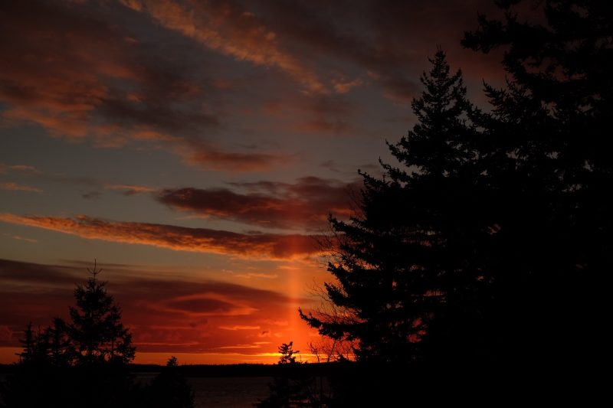
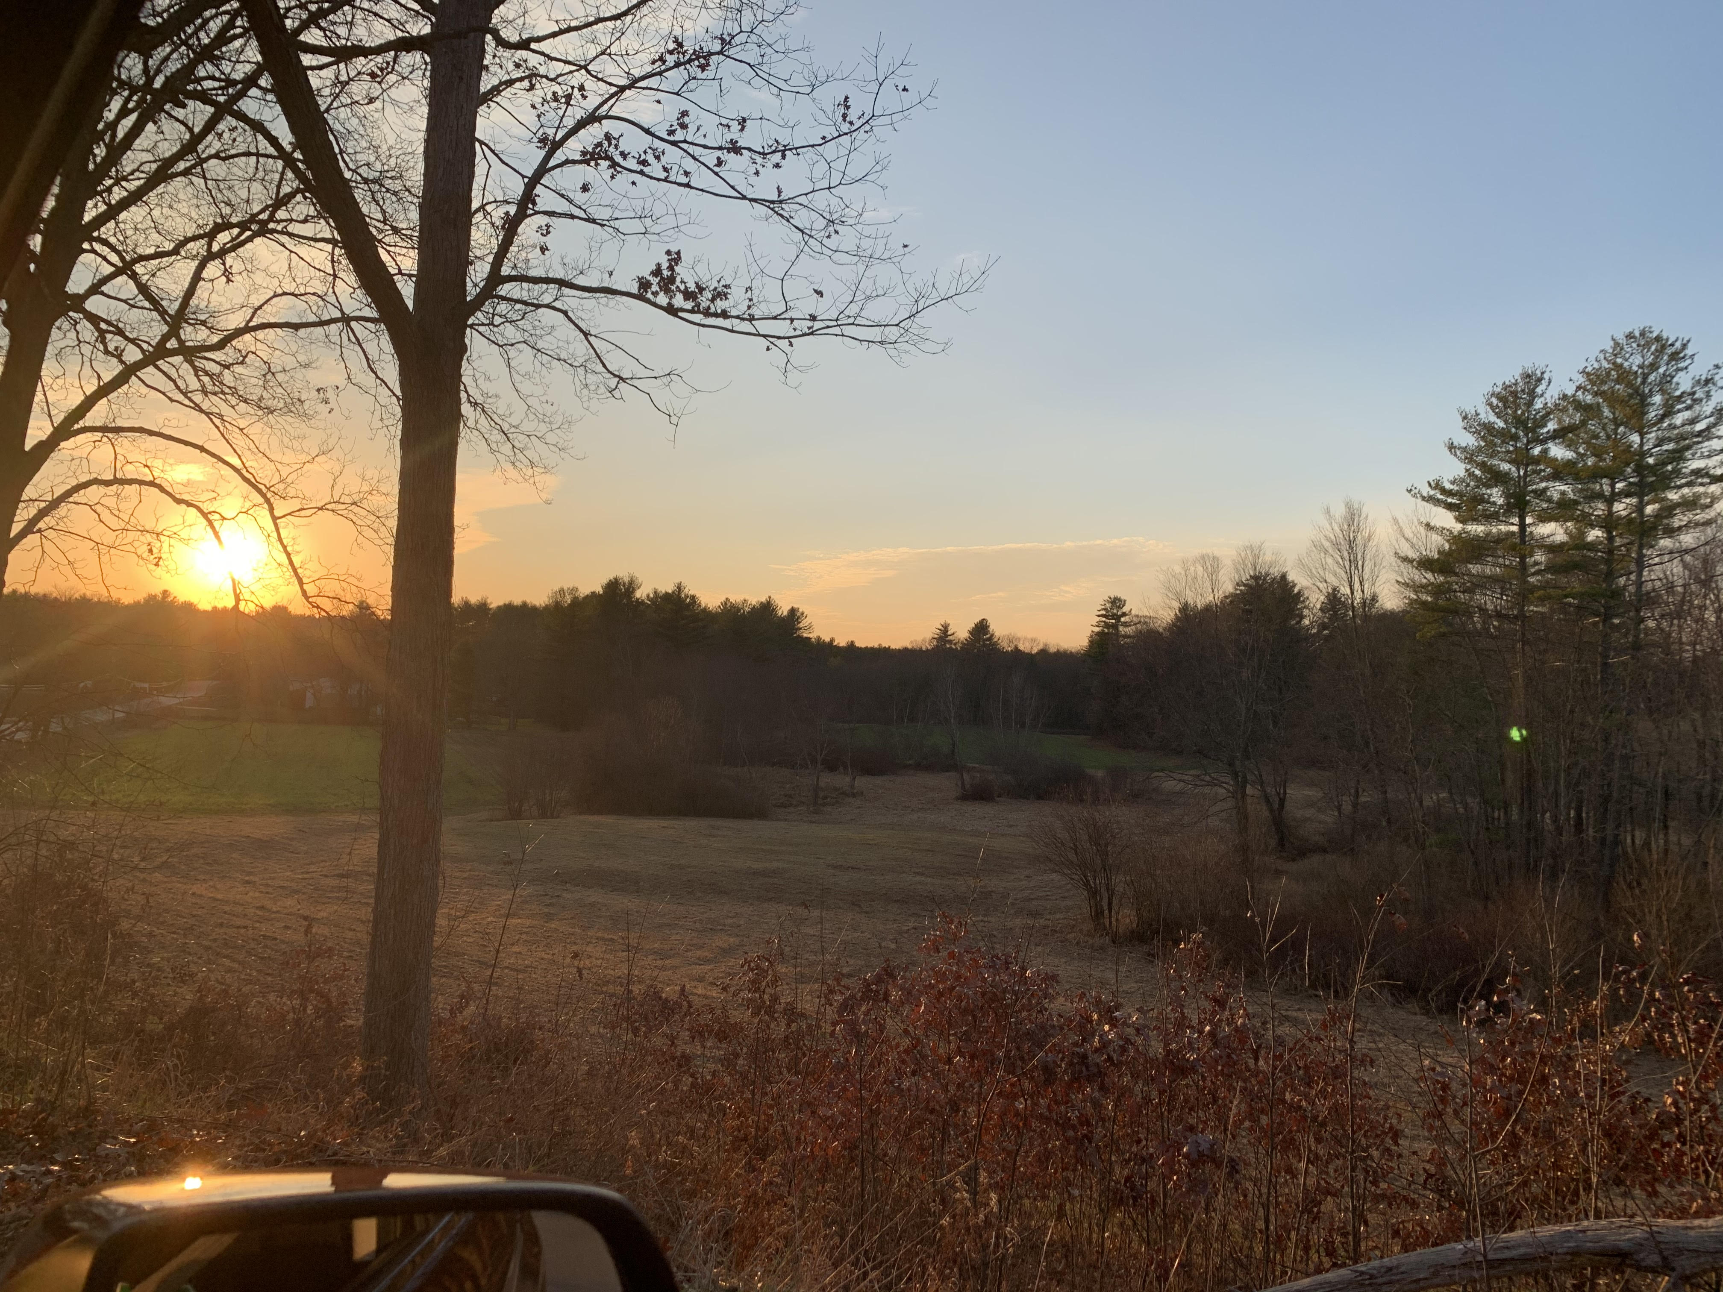
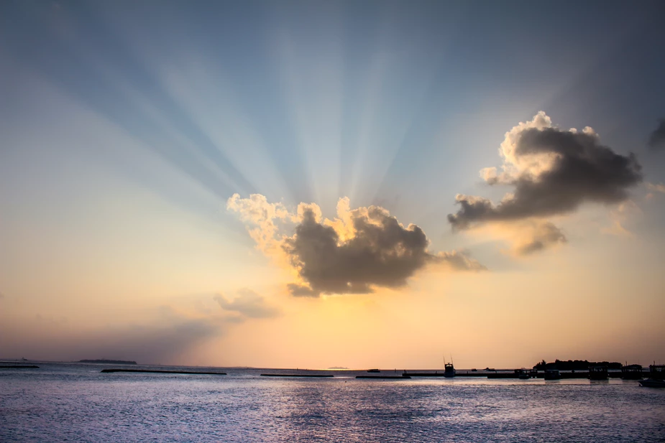
Workable Pictures for Sunset Project
A little after sunset, but “sun pillar” lets you determine Sun’s azimuth.
The Sun is behind a cloud, but “sun beams” point back to its position.

Slide 18
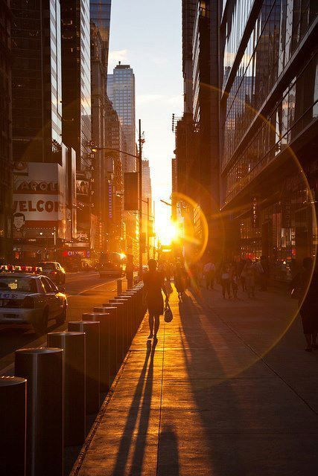
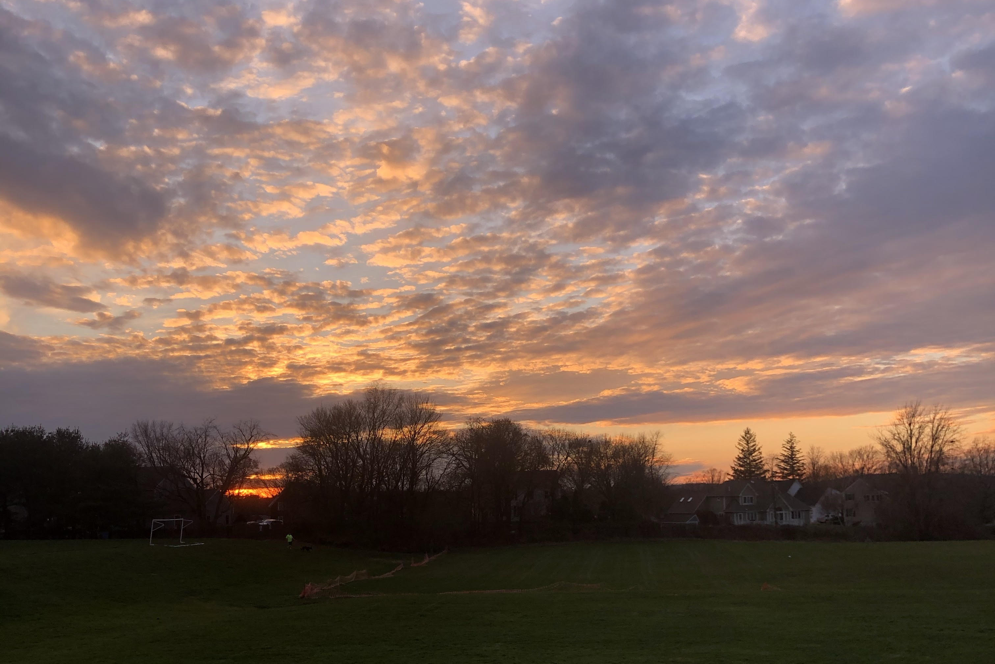
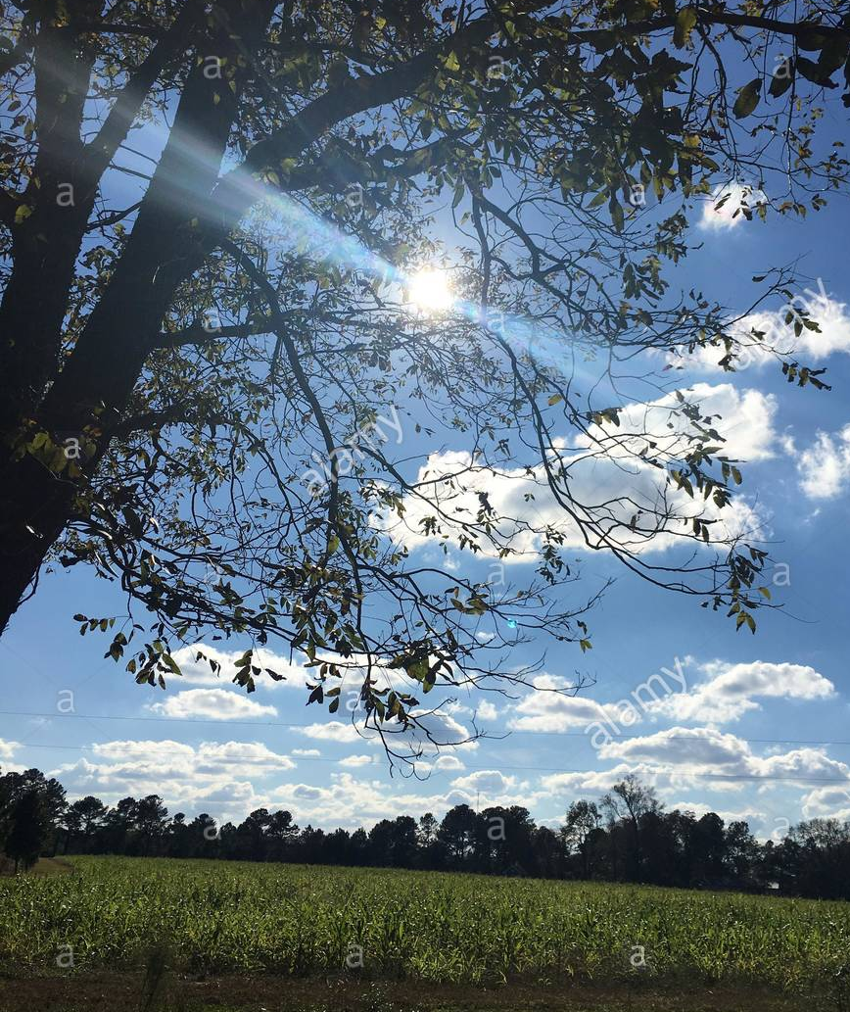
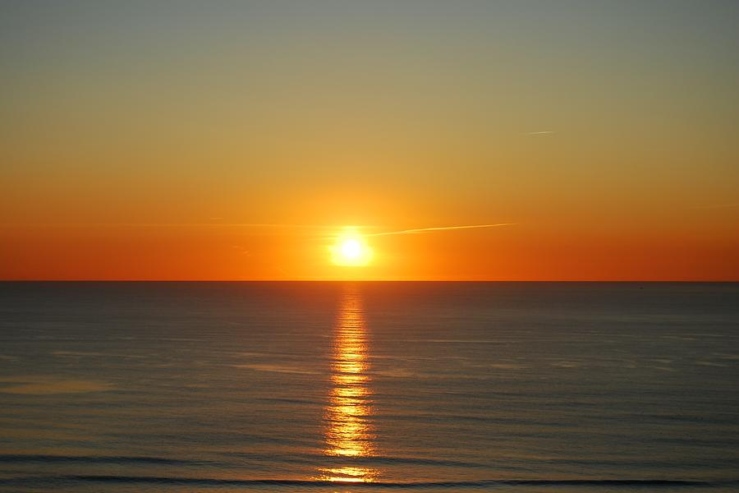
Pretty Pictures with Problems!
Can’t tell Sun’s azimuth
Not enough horizon to view Sun on later dates
No features on horizon
Not near enough horizon

Slide 19
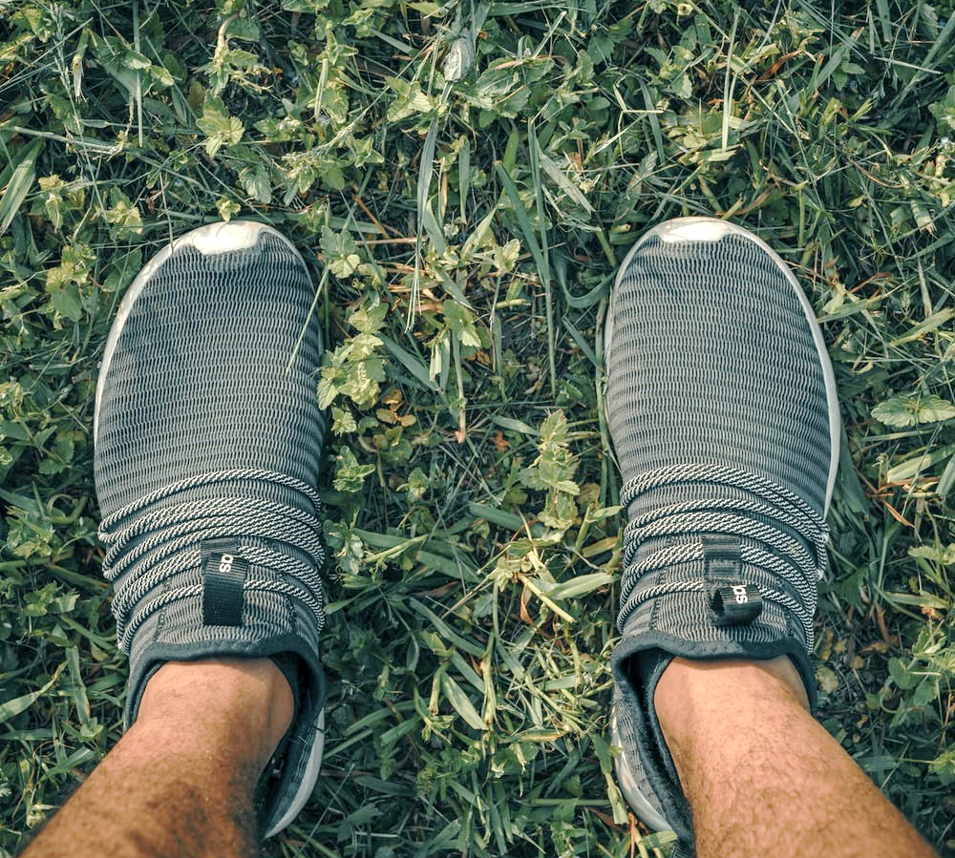
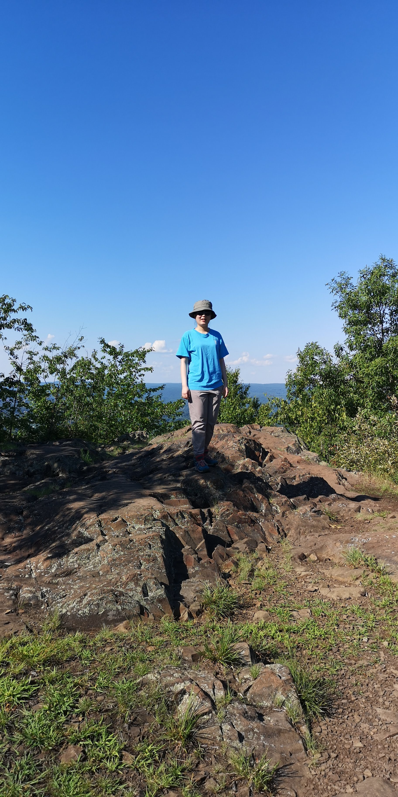
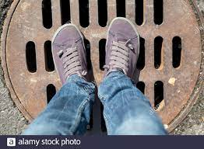
Documenting your location… You will probably need to show a picture of a map along with photos that show clearly where you are standing when you take your pictures. Someone else should be able to return to the exact same spot to take a follow-up picture.

Slide 20
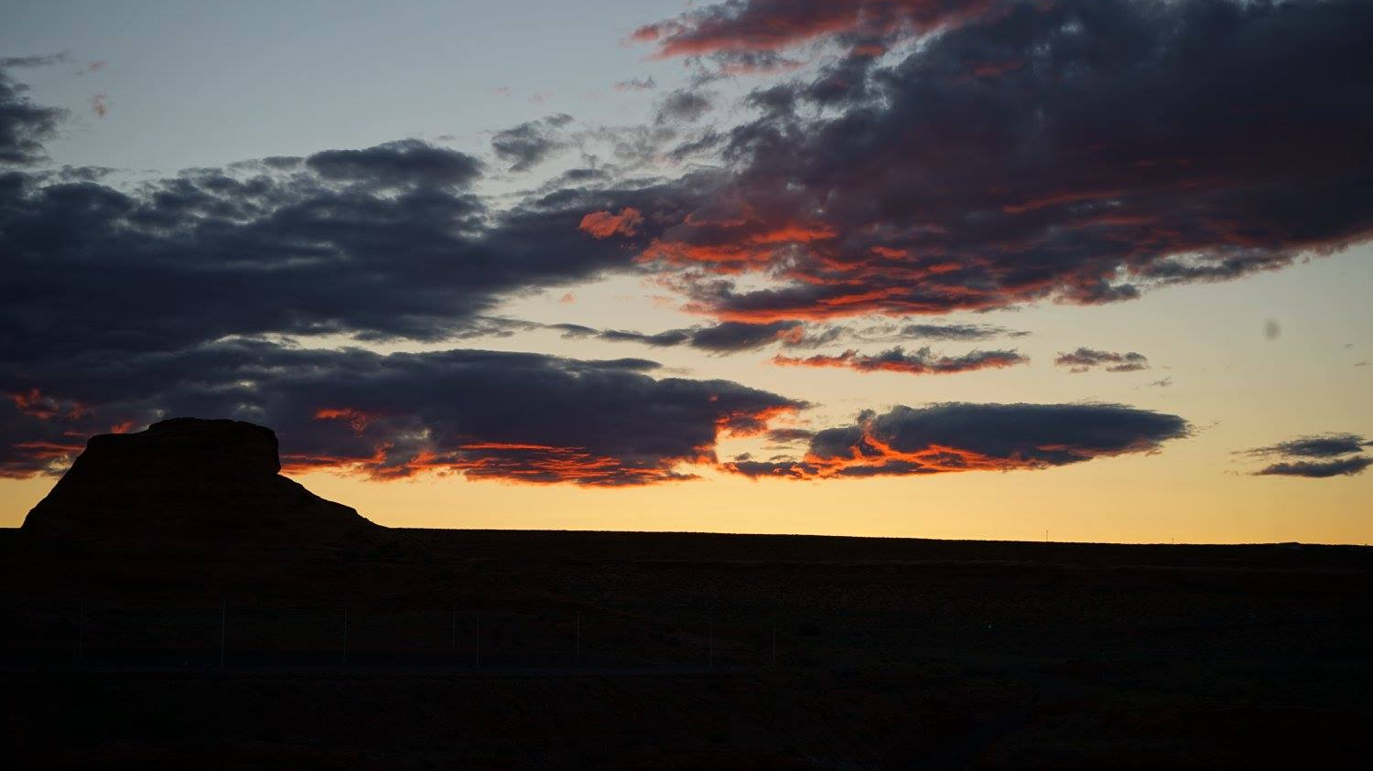
Due dates: 1 Mar – camera calibration grids 11 Mar – 1st sunset picture 19 Apr – project submission including 2 more sunset pictures
Yvonne Ban
Arizona
20 May 2017

Slide 21
Part 5: End of Lab quiz
Password: squ!d
Don’t forget to submit your camera calibration pictures on Moodle (no later than March 1).
Make sure to fill out the end-of-Lab quiz on Moodle before you leave! IF YOU CANNOT, YOU MUST MAKE ARRANGEMENTS WITH YOUR LAB INSTRUCTOR BEFORE YOU LEAVE!

